Slide 1
Computer Organization
Chapter 4
Logic design of sequential circuits
Notes:
时序线路的逻辑设计

Slide 2
Chapter 4 logic design of sequential circuits
4.1 General model of sequential circuits
4.2 Flip-flops
4.3 Synthesis of sequential logic circuits
4.4 Summary
Notes:
时序线路的逻辑设计
4.1 时序线路的普遍模型
4.2 触发器
4.3 MSI时序逻辑线路的综合
4.4 小结

Slide 3
4.1 General model of sequential circuits
inputs
Combinational
circuit
output
…
…
…
…
Next states
Current
states
…
memory
…
clock
outputs = f（inputs，current states）
Next states = g（inputs，current states）
Notes:
时序线路实现一个时序逻辑函数。
它的参数不仅有输入变量，还有状态变量。
状态变量反映了过去的输入量对线路现有输出量的影响。
时序线路需要存储元件来保存状态变量。

Slide 4
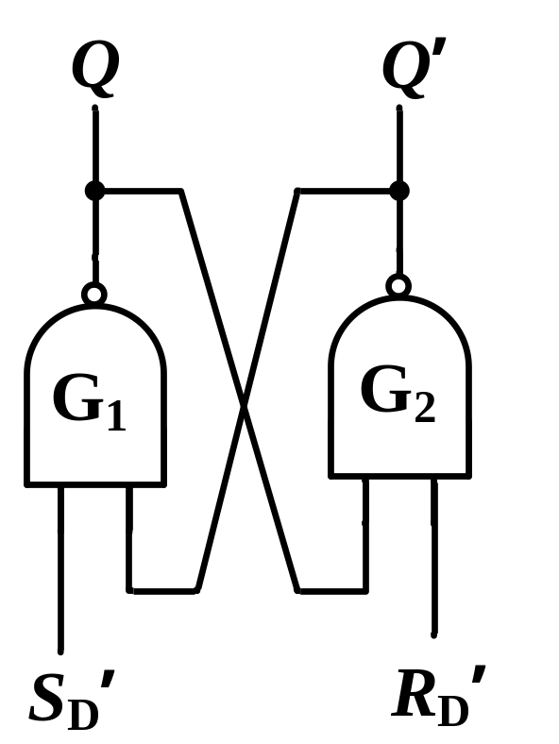


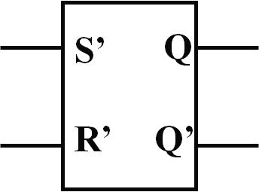
4.2 Flip-flops
Analysis of a simple RS latch （SR暂存器）
Vo1
Vo2
Vi2
Notes:
简单SR暂存器的分析

Slide 5
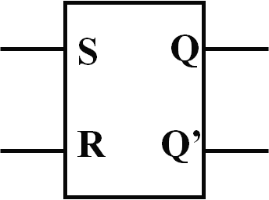
4.2 Flip-flops
Analysis of a simple RS latch （SR暂存器）
Vi1
Q
Q
Vo1
Vo2
Vi2
S
R
Notes:
简单SR暂存器的分析

Slide 6
4.2 Flip-flops
Analysis of a simple RS latch （RS暂存器置位、复位）
R = 0, S = 1 R = 0，S = 1
Q = 0 ----> Q = 1 Q = 1
R = 1, S = 0 R = 1 ，S = 0
Q = 1 ----> Q = 0 Q = 0
S
S Q
R Q
Q
Q
R
--->Q = 1 State ‘1’
--->Q = 0 State ‘0’
Notes:
简单SR暂存器的分析

Slide 7
4.2 Flip-flops
Analysis of a simple SR latch （RS暂存器 保持状态）
R = 0, S = 0, Q(t) = 0 State ‘0’
S = 0
Q(t) = 0
R = 0, S = 0, Q(t) = 1 State ‘1’
Q(t) = 1 ---> Q(t+1) = 0
R = 0
S
S Q
R Q
Q
Q
R
--->Q(t+1) = 1 ---> Q(t+1) = 0 State no change
--->Q(t+1) = 1 State no change

Slide 8
4.2 Flip-flops
S Q
R Q
Analysis of a simple SR latch
The reduced state transition table of an SR latch
excitation |  |  | Next state
S | R | Q(t)
0 | 0 | Q(t) | Q* = Q(t)
0 | 1 | × | Q* = 0
1 | 0 | × | Q* = 1
1 | 1 | × | Not defined

Slide 9
4.2 Flip-flops
SR Flip-Flop（同步RS触发器）
The excitation table of an SR flip-flop
excitation |  | Next state Q(t) Q(t+1)
S | R
0 | X | 0 0
1 | 0 | 0 1
0 | 1 | 1 0
X | 0 | 1
S Q
clk
R Q
S
Q
Clock
Q
R

Slide 10
4.2 Flip-flops
Preset
J
Q
J-K flip-flop
Clock
K
Q
J S Q
clk
K C Q
Clear
inputs output
S CLR CLK J K Q
1 1 0 0 stay
1 1 1 0 1
1 1 0 1 0
1 1 1 1 flip
0 1 X X X 1
1 0 X X X 0
J，K：inputs；
CLK：clock;
S：set；CLR：clear；
Q：output

Slide 11
4.2 Flip-flops
D flip-flop
Preset
D
Q
D S Q
clk
C Q
Clock
Q
Clear
The reduced state transition table of a D flip-flop
excitation | State Transitions | excitation | State Transitions
D |  | D
0 | Q(t+1) = 0 | 1 | Q(t+1) = 1

Slide 12
4.1 General model of sequential circuits
Synchronous sequential logic circuits
  The current state variables can change values only at discrete fixed time instants.
Asynchronous sequential logic circuits
  The current state variables change values in accordance with the change of input variables in a random fashion, not in synchronism with a clock signal.
Most of the sequential circuits encountered in computer organization are synchronous circuits.
Notes:
同步时序逻辑线路
现状态变量仅能在固定的时刻改变，则称为同步的。
异步时序逻辑线路
现状态变量以随机的方式根据输入变量的改变而随时改变，不和时钟信号同步，则称为是异步的。
计算机中遇到的绝大多数时序逻辑线路都是同步线路。

Slide 13
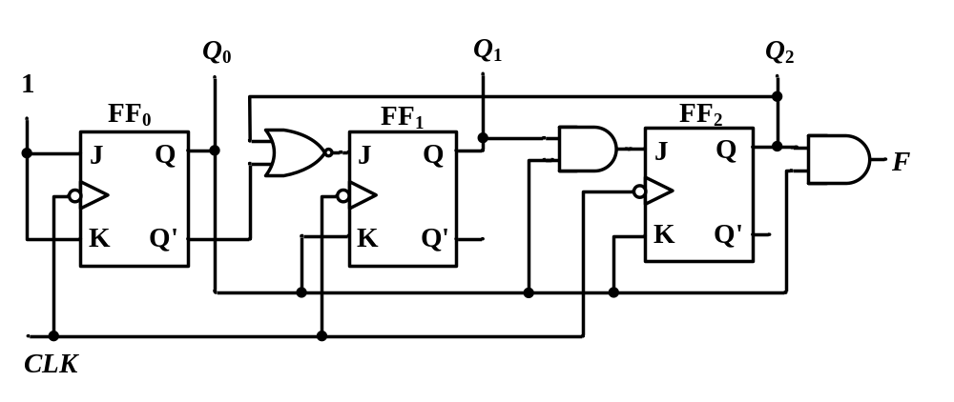
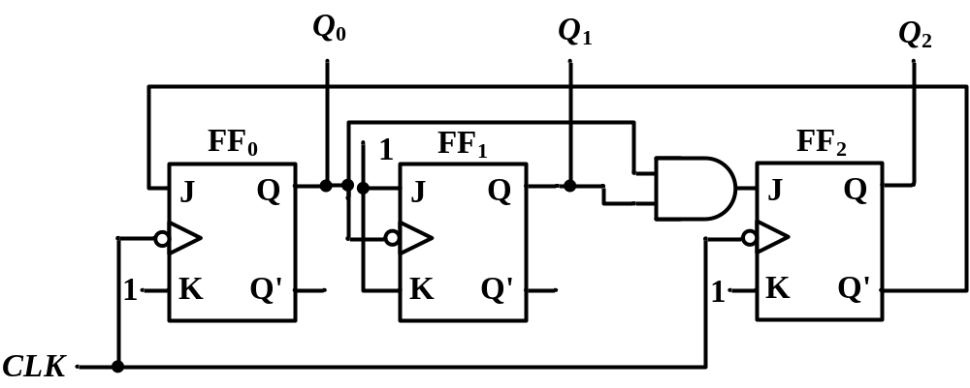
Synchronous sequential logic circuits
Asynchronous sequential logic circuits

Slide 14
4.3 Synthesis of MSI sequential logic circuits
sequential logic circuits
Write Clock equation
Write excitation equation
Write Output equation
Characteristic equation
state Equation
State transition table
Timing Diagram
State transition diagram
Summary logic function

Slide 15
4.3 Synthesis of MSI sequential logic circuits
Register
A register can be constructed with any of the types of flip-flops (J-k flip-flop, D flip-flop and so on)
Q3
J CLK K
Q2
J CLK K
Q1
J CLK K
Q0
J CLK K
Clock
load
I3
I2
I1
I0

Slide 16
4.3 Synthesis of MSI sequential logic circuits
Register
A register can be constructed with any of the types of flip-flops (J-k flip-flop, D flip-flop and so on)
Q3
D CLK
Q2
D CLK
Q1
D CLK
Q0
D CLK
Clock
Maintain load
load
I3
I2
I1
I0

Slide 17
4.3 Synthesis of MSI sequential logic circuits
Shift register
X1 X2 X3 X4
Serial inputs
D_{IN}
D1 Q1
F1
CLK
D2 Q2
F2
CLK
D3 Q3
F3
CLK
D4 Q4
F4
CLK
Shift right
CLK
D_{IN}
CLK
X1
X2
X3
X4
1 0 1 1 0
waveform of serial input & parallel output right shift register
1 0 1 1 0
1 0 1 1
1 0 1
1 0

Slide 18
4.3 Synthesis of MSI sequential logic circuits
counter
Q0 Q1 Q2 Q3
1
J Q
CLK
K CLR
J Q
CLK
K CLR
J Q
CLK
K CLR
J Q
CLK
K CLR
Clk
clear
1 2 3 4 5 6 7 8 9 10 11 12 13 14 15 16
CLK
Q0
Q1
Q2
Q3

Slide 19
试分析下图所示的同步时序逻辑电路的逻辑功能。FF₀、FF₁、FF₂是3个JK触发器，时钟脉冲为下降沿触发。

Slide 20
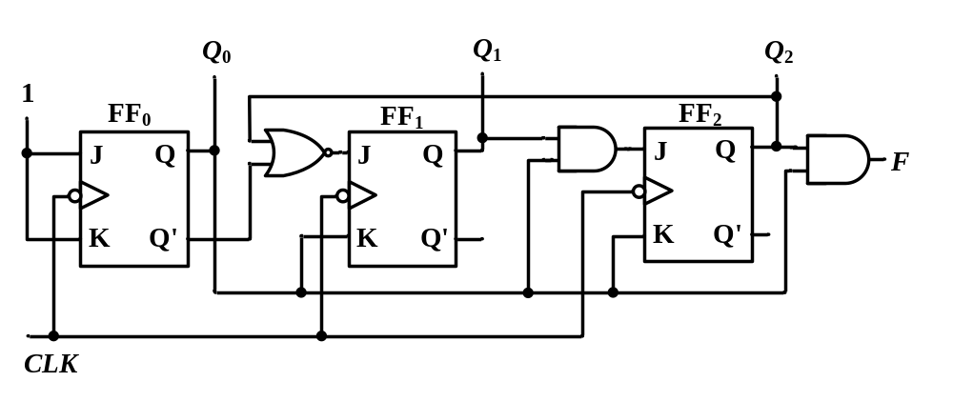
解：⑴ 写驱动方程和输出方程
  J₀=K₀=1 J₁=(Q₀'+ Q₂)' K₁= Q₀
  J₂=Q₀ Q₁ K₂= Q₀ F= Q₀ Q₂

Slide 21
⑵ 求状态方程
  将各触发器的驱动方程代入到JK触发器的特性方程Q*=JQ'+K'Q中，得到相应的状态方程
  J₀=K₀=1 J₁=(Q₀'+ Q₂)' K₁= Q₀
  J₂=Q₀ Q₁ K₂= Q₀ F= Q₀ Q₂
    Q₀*=Q₀'
    Q₁*=Q₀ Q₂' Q₁'+Q₀'Q₁
    Q₂*=Q₀ Q₁ Q₂'+Q₀' Q₂

Slide 22
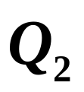

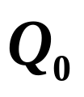
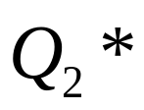
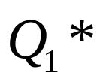
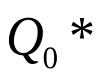
    Q0*=Q0'
    Q1*=Q0 Q2' Q1'+Q0'Q1
    Q2*=Q0 Q1 Q2'+Q0' Q2
⑶ 列状态转换真值表，画状态转换图及时序波形图
表6-1 例6-1的状态转换表
CLK顺序
F
1
2
3
4
5
6
0 0 0
0 0 1
0 1 0
0 1 1
1 0 0
1 0 1
0 0 1
0 1 0
0 1 1
1 0 0
1 0 1
0 0 0
0
0
0
0
0
1
1 1 0
1 1 1
1 1 1
0 0 0
0
1

Slide 23
有效状态
无效状态
由状态转换表很容易画出状态转换图
110
CP
1
2
3
4
5
6
7
Q₀
0
1
1
Q₂Q₁Q₀
Q₁
0
0
111
0
Q₂
1
000
001
010
F
图6-4 例6-1的波形图
有效循环
101
100
011
自启动
Notes:
该电路是同步六进制加法计数器，能自启动。

Slide 24
Summary
4.1 General model of sequential circuits
4.2 Flip-flops
  SR latch
  SR Flip-Flop
  J-K Flip-Flop
  D Flip-Flop
4.3 Synthesis of sequential logic circuits
  Register ( J-K flip-flop or D flip-flop)
  Shift register ( D flip-flop)
  counter( J-K flip-flop)
inputs
Combinational
circuit
output
…
…
…
…
Current
states
memory
Next states
…
…
clock

